Slide 1
PREDICTING CUSTOMER BOOKING BEHAVIOUR
BRITISH AIRWAYS FORAGE

Slide 2
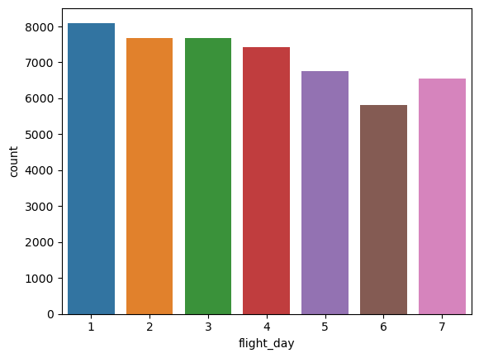
Analysis on the dataset
From the visualization here, the most number of flights were booked on Mondays and least on Saturdays. This could be because the prices of tickets are high during weekends, so customers prefer booking flights during weekdays when the price is low.

Slide 3
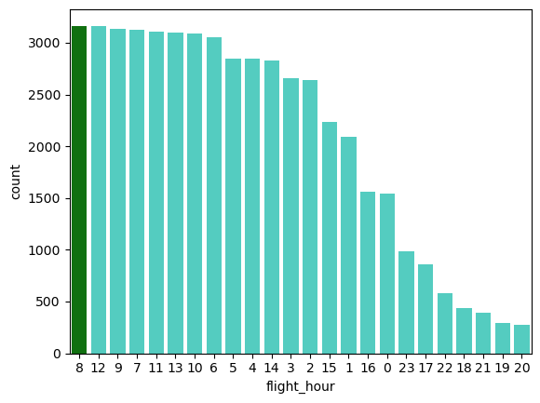
Analysis on the dataset
Most of the flights took off at 8 in the morning and the least was 8 at night. This could be because of the convenience of travelling to airports and the few people who travel to business meetings. More number of flights can be increased during the night times.

Slide 4
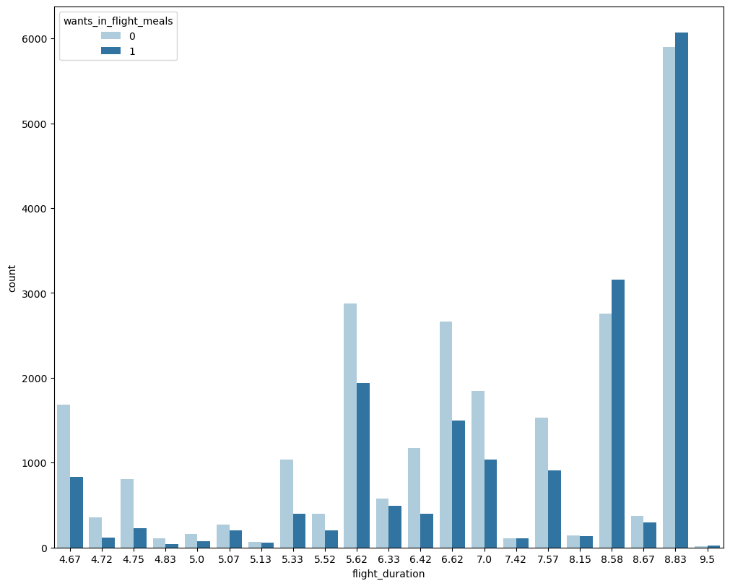
Analysis of the dataset
With the increase in flight duration, the number of people requesting for meals is increasing. Quality of food should therefore be maintained for longer flights.

Slide 5
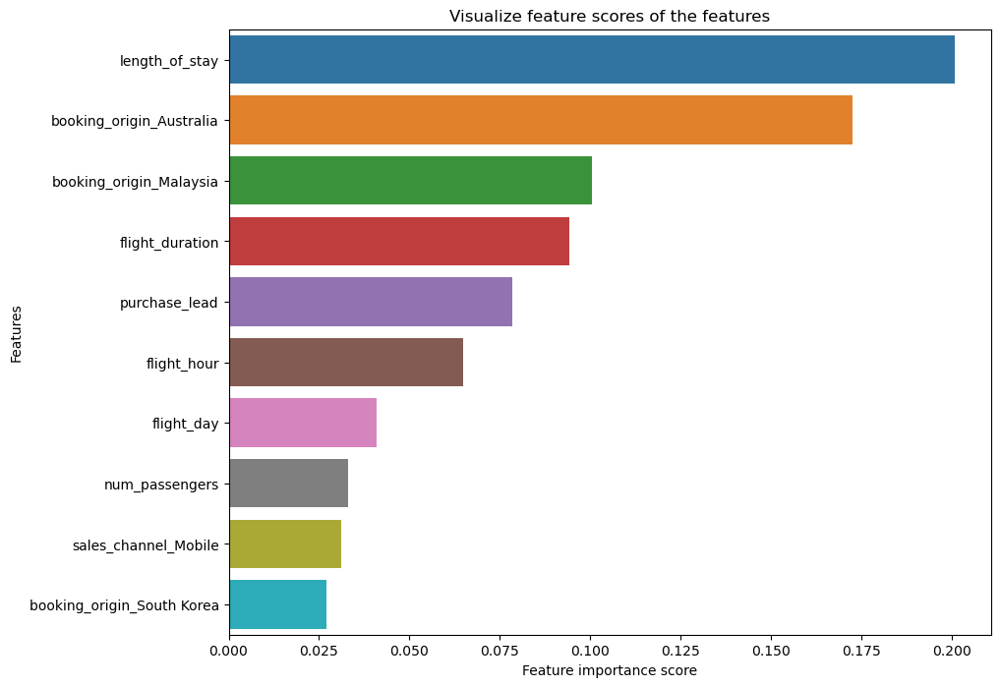
Prediction of customer behaviour
These are the main features influencing customer behaviour in making a booking.
The highest factor influencing customer booking is the length of stay.
Based on the length of stay, flight duration and the price the airline is charging, people are deciding whether to book the tickets or not.
Therefore the prices can be changed accordingly to accommodate more number of bookings.
The accuracy of the model is 77%. Therefore, the model needs improvement.

